Slide 1
OPER 618 Lesson 06 Computing NE for n-player games & Other Computing Concepts
Dr. Brian J. Lunday
Office: Rm 201E, Bldg 641

Slide 2
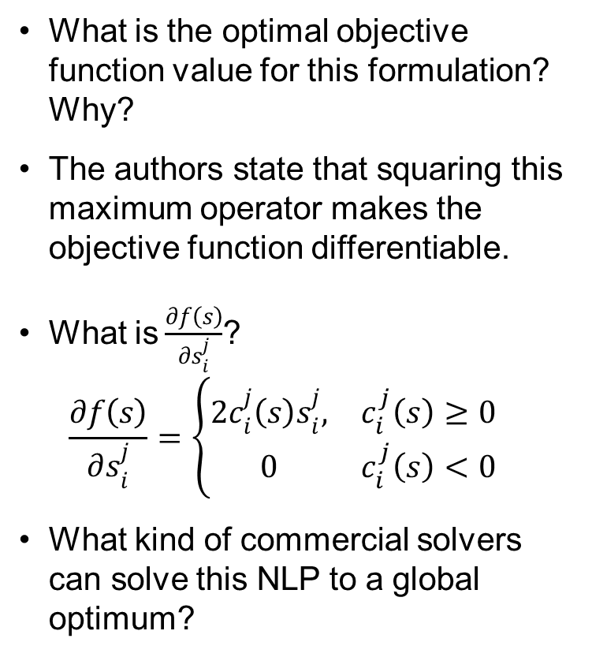
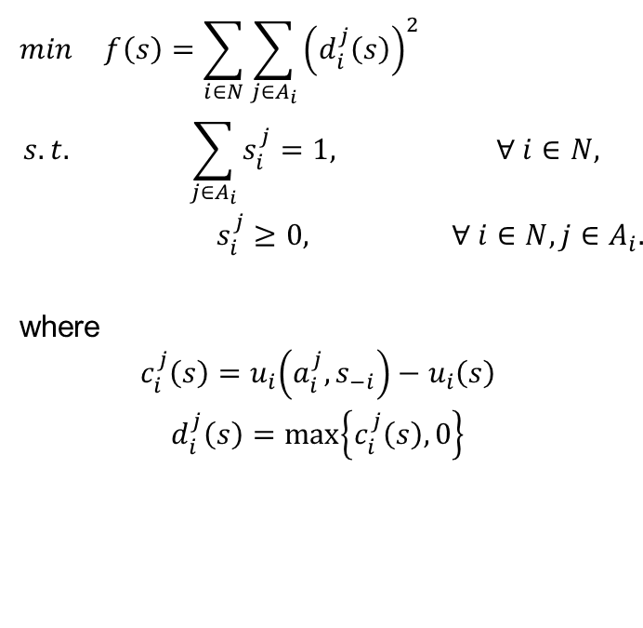
Computing NE for n-player Games Constrained Formulation
$$\begin{matrix}min & f\left(s\right)=\sum_{i∈N}{\sum_{j∈A_{i}}{{\left(d_{i}^{j}\left(s\right)\right)}^{2}}} & \\ s.t. & \sum_{j∈A_{i}}{s_{i}^{j}}=1, & ∀ i∈N, \\ & s_{i}^{j}≥0, & ∀ i∈N, j∈A_{i}.\end{matrix}$$
where
$$\begin{matrix}c_{i}^{j}\left(s\right)=u_{i}\left(a_{i}^{j},s_{−i}\right)−u_{i}\left(s\right) \\ d_{i}^{j}\left(s\right)=\max\left\{c_{i}^{j}\left(s\right),0\right\}\end{matrix}$$
What is the optimal objective function value for this formulation? Why?
The authors state that squaring this maximum operator makes the objective function differentiable.
What is$\frac{∂f\left(s\right)}{∂s_{i}^{j}}$?
$$\frac{∂f\left(s\right)}{∂s_{i}^{j}}=\left\{\begin{matrix}2c_{i}^{j}\left(s\right)s_{i}^{j}, & c_{i}^{j}\left(s\right)≥0 \\ 0 & c_{i}^{j}\left(s\right)<0\end{matrix}\right.$$
What kind of commercial solvers can solve this NLP to a global optimum?

Slide 3
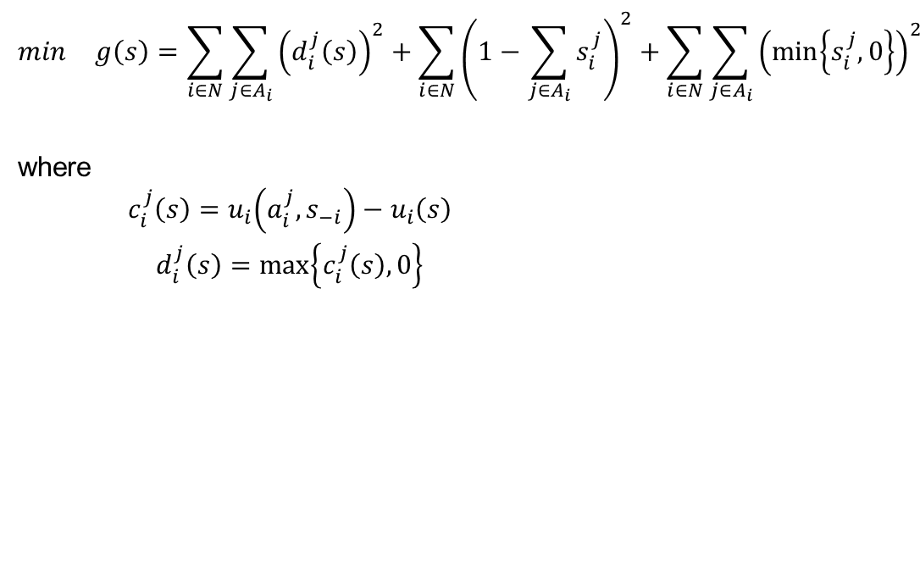
Computing NE for n-player Games Unconstrained Formulation
$$\begin{matrix}min & g\left(s\right)=\sum_{i∈N}{\sum_{j∈A_{i}}{{\left(d_{i}^{j}\left(s\right)\right)}^{2}}}+\sum_{i∈N}{{\left(1−\sum_{j∈A_{i}}{s_{i}^{j}}\right)}^{2}}+\sum_{i∈N}{\sum_{j∈A_{i}}{{\left(\min\left\{s_{i}^{j},0\right\}\right)}^{2}}}\end{matrix}$$
where
$$\begin{matrix}c_{i}^{j}\left(s\right)=u_{i}\left(a_{i}^{j},s_{−i}\right)−u_{i}\left(s\right) \\ d_{i}^{j}\left(s\right)=\max\left\{c_{i}^{j}\left(s\right),0\right\}\end{matrix}$$
What is the optimal objective function value for this formulation? Why?
Why is global convergence challenging for this formulation?
What kind of commercial solvers can solve this NLP to a global optimum?

Slide 4
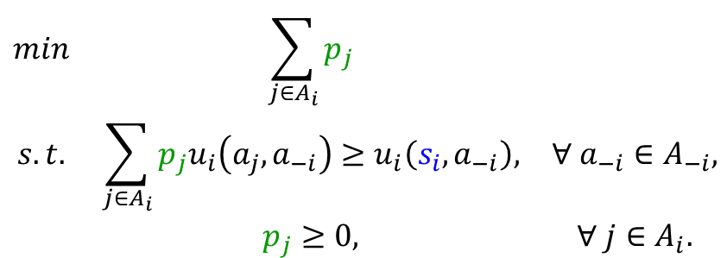

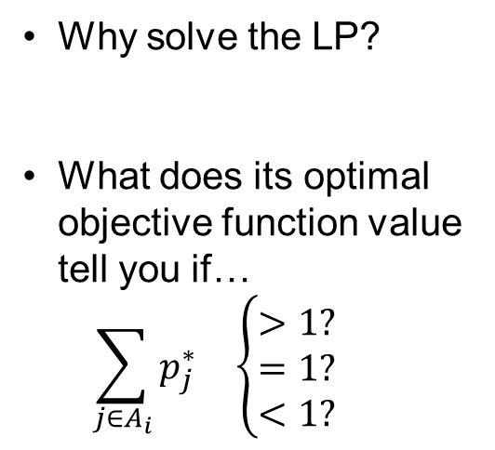
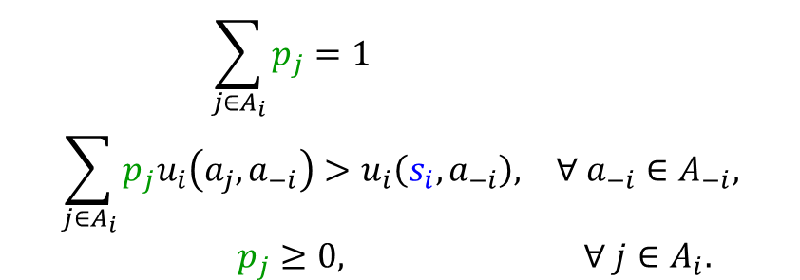
Is Strategy $s_{i}$ Strictly Dominated?
System of Equations and Strict Inequalities
$$\begin{matrix}\sum_{j∈A_{i}}{p_{j}}=1 & \\ \sum_{j∈A_{i}}{p_{j}u_{i}\left(a_{j},a_{−i}\right)}>u_{i}\left(s_{i},a_{−i}\right), & ∀ a_{−i}∈A_{−i}, \\ p_{j}≥0, & ∀ j∈A_{i}.\end{matrix}$$
Why solve the LP?
What does its optimal objective function value tell you if…
$$\sum_{j∈A_{i}}{p_{j}^{∗}} \left\{\begin{aligned}>1? \\ =1? \\ <1?\end{aligned}\right.$$
Linear Program
$$\begin{matrix}min & \sum_{j∈A_{i}}{p_{j}} & \\ s.t. & \sum_{j∈A_{i}}{p_{j}u_{i}\left(a_{j},a_{−i}\right)}≥u_{i}\left(s_{i},a_{−i}\right), & ∀ a_{−i}∈A_{−i}, \\ & p_{j}≥0, & ∀ j∈A_{i}.\end{matrix}$$

Slide 5


Is Strategy $s_{i}$ Very Weakly Dominated?
System of Equations and Strict Inequalities
$$\begin{matrix}\sum_{j∈A_{i}}{p_{j}}=1 & \\ \sum_{j∈A_{i}}{p_{j}u_{i}\left(a_{j},a_{−i}\right)}≥u_{i}\left(s_{i},a_{−i}\right), & ∀ a_{−i}∈A_{−i}, \\ p_{j}≥0, & ∀ j∈A_{i}.\end{matrix}$$
Why solve the LP?
What does its optimal objective function value tell you if…
$$\sum_{j∈A_{i}}{p_{j}^{∗}} \left\{\begin{aligned}>1? \\ =1? \\ <1?\end{aligned}\right.$$
Linear Program (same LP as for s.d.)
$$\begin{matrix}min & \sum_{j∈A_{i}}{p_{j}} & \\ s.t. & \sum_{j∈A_{i}}{p_{j}u_{i}\left(a_{j},a_{−i}\right)}≥u_{i}\left(s_{i},a_{−i}\right), & ∀ a_{−i}∈A_{−i}, \\ & p_{j}≥0, & ∀ j∈A_{i}.\end{matrix}$$

Slide 6
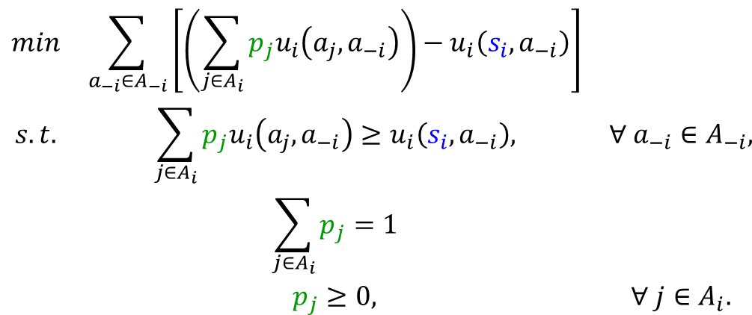

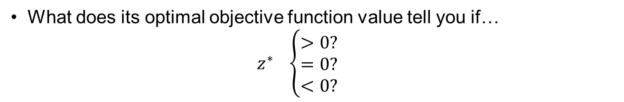
Is Strategy $s_{i}$ Weakly Dominated?
Linear Program
$$\begin{matrix}min & \sum_{a_{−i}∈A_{−i}}{\left[\left(\sum_{j∈A_{i}}{p_{j}u_{i}\left(a_{j},a_{−i}\right)}\right)−u_{i}\left(s_{i},a_{−i}\right)\right]} & \\ s.t. & \sum_{j∈A_{i}}{p_{j}u_{i}\left(a_{j},a_{−i}\right)}≥u_{i}\left(s_{i},a_{−i}\right), & ∀ a_{−i}∈A_{−i}, \\ & \sum_{j∈A_{i}}{p_{j}}=1 & \\ & p_{j}≥0, & ∀ j∈A_{i}.\end{matrix}$$
What does its optimal objective function value tell you if…
$$z^{∗} \left\{\begin{aligned}>0? \\ =0? \\ <0?\end{aligned}\right.$$

Slide 7
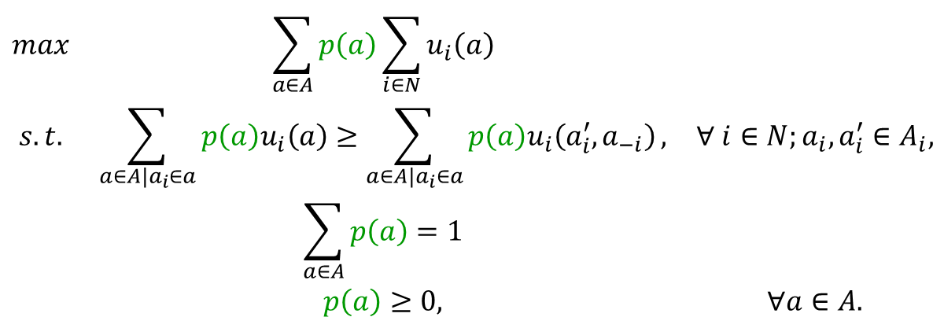
Correlated Equilibria
Linear Program
$$\begin{matrix}max & \sum_{a∈A}{p\left(a\right)\sum_{i∈N}{u_{i}\left(a\right)}} & \\ s.t. & \sum_{a∈A|a_{i}∈a}{p\left(a\right)u_{i}\left(a\right)}≥\sum_{a∈A|a_{i}∈a}{p\left(a\right)u_{i}\left(a_{i}^{′},a_{−i}\right)}, & ∀ i∈N;a_{i},a_{i}^{′}∈A_{i}, \\ & \sum_{a∈A}{p\left(a\right)}=1 & \\ & p\left(a\right)≥0, & ∀a∈A.\end{matrix}$$
What other objective functions for the formulation above would yield a Correlated Equilibrium?
What’s the relationship between Nash equilibria and Correlated Equilibria?
For what type of games can the formulation above find NE?

Slide 8
Questions & Discussion

